Slide 1
VENROUTE (SALES OF Evs)
PURE EV
BOOM MOTORS
BGAUSS
EARTH ENERGY
FRANKLIN EV
VENERGY
(CHARGING STATIONS)
SOCKET
CHARZER
VEASE
(SERVICE STATIONS)
VEQUIPMENT
(ONLINE SALES OF EV SPARES) - COMING SOON
VESSENTIAL
(APP AND WEB APPLICATION) - COMING SOON

Slide 2

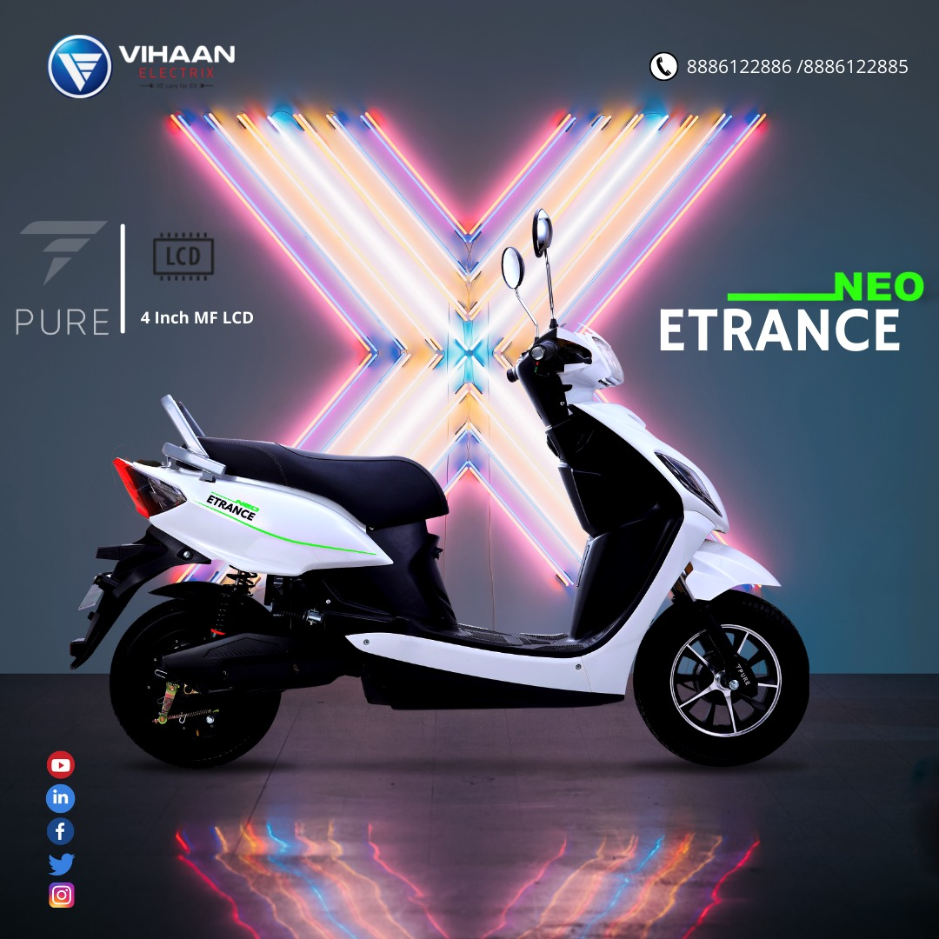




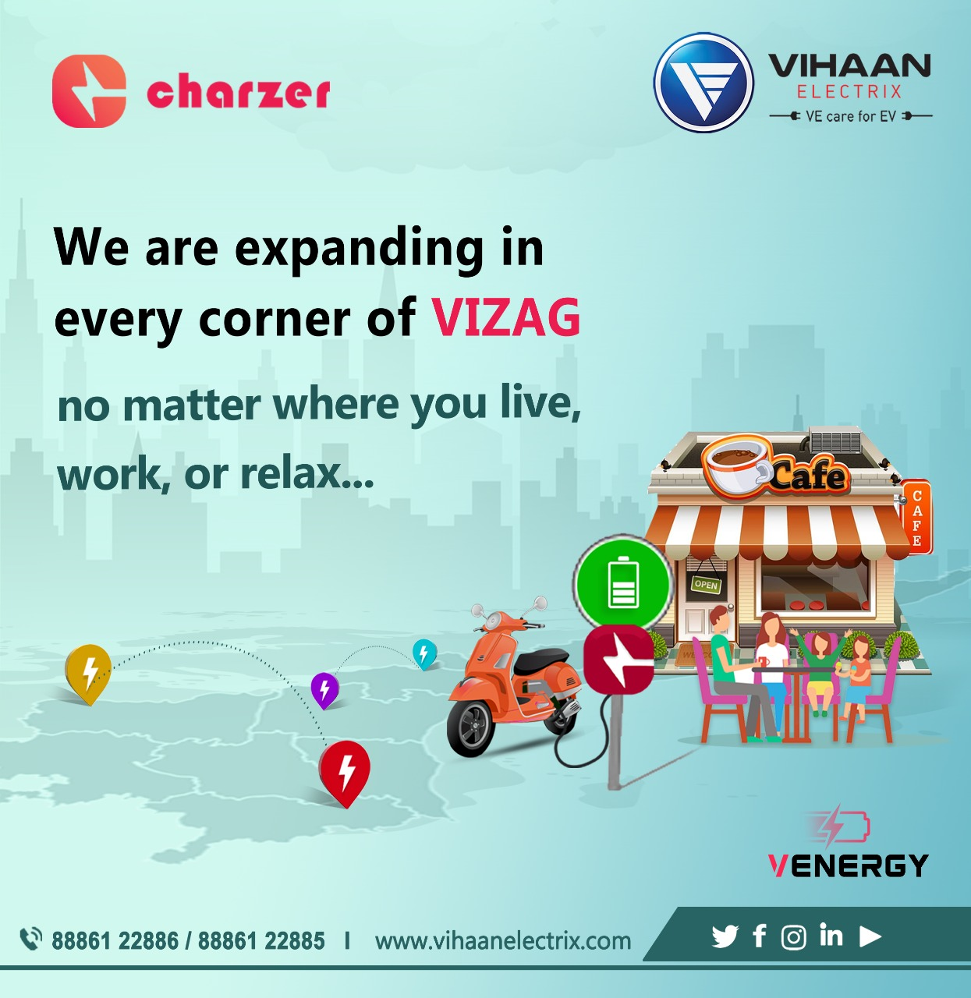






LOGO ANIMATION
HOME PAGE
MENU BAR (VERTICALS)
VENROUTE
VENERGY
VEASE
VEQUIPMENT
VESSENTIAL

Slide 3
VENROUTE

Slide 4



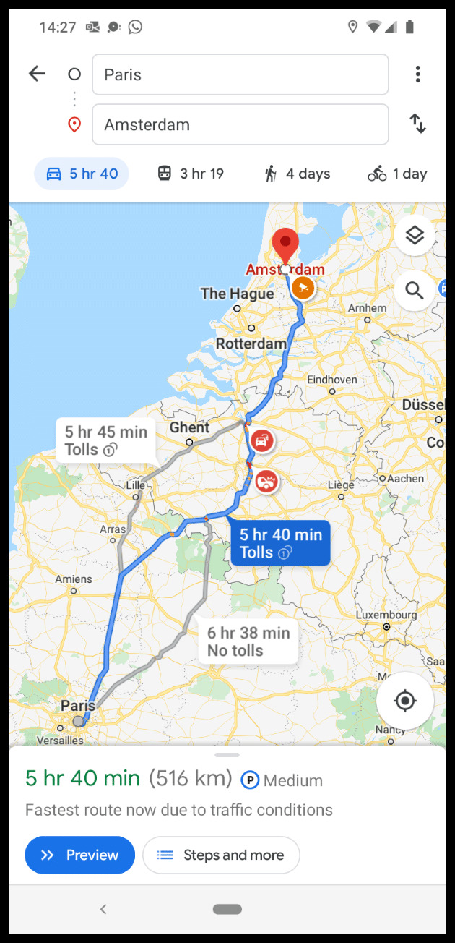

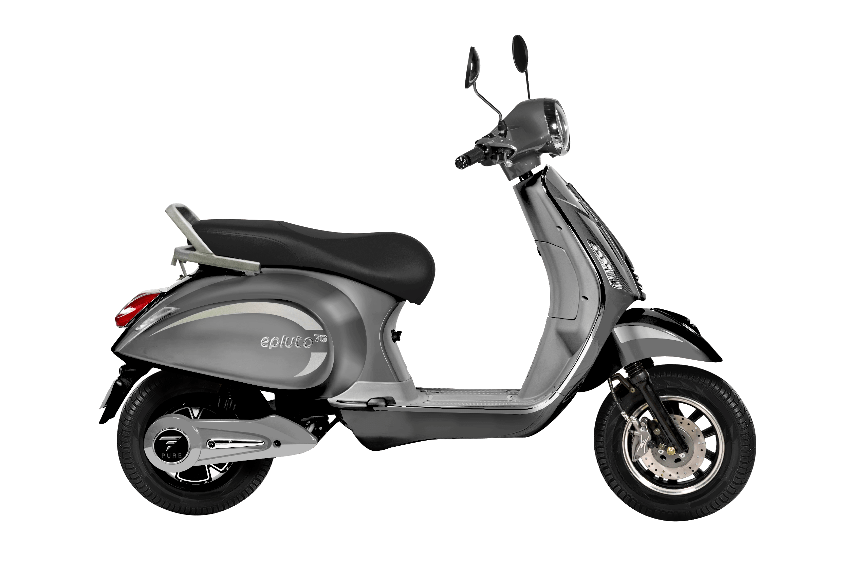

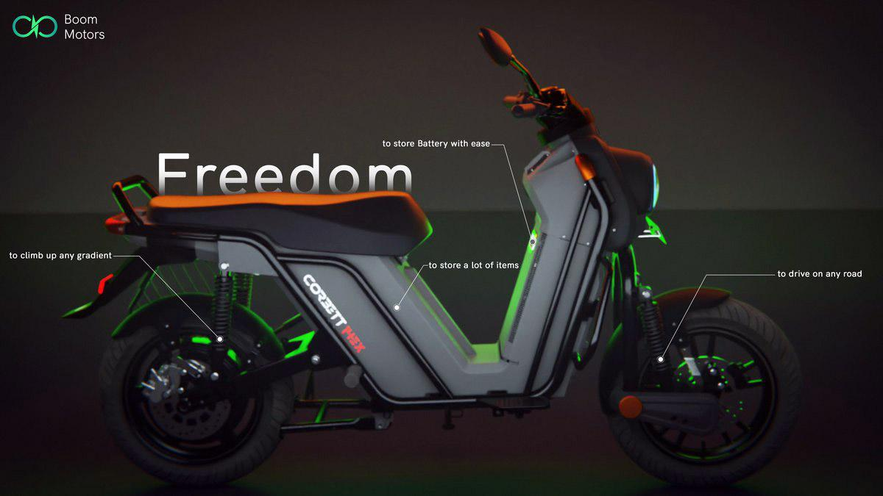

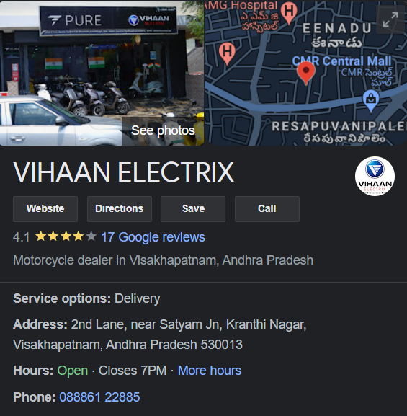

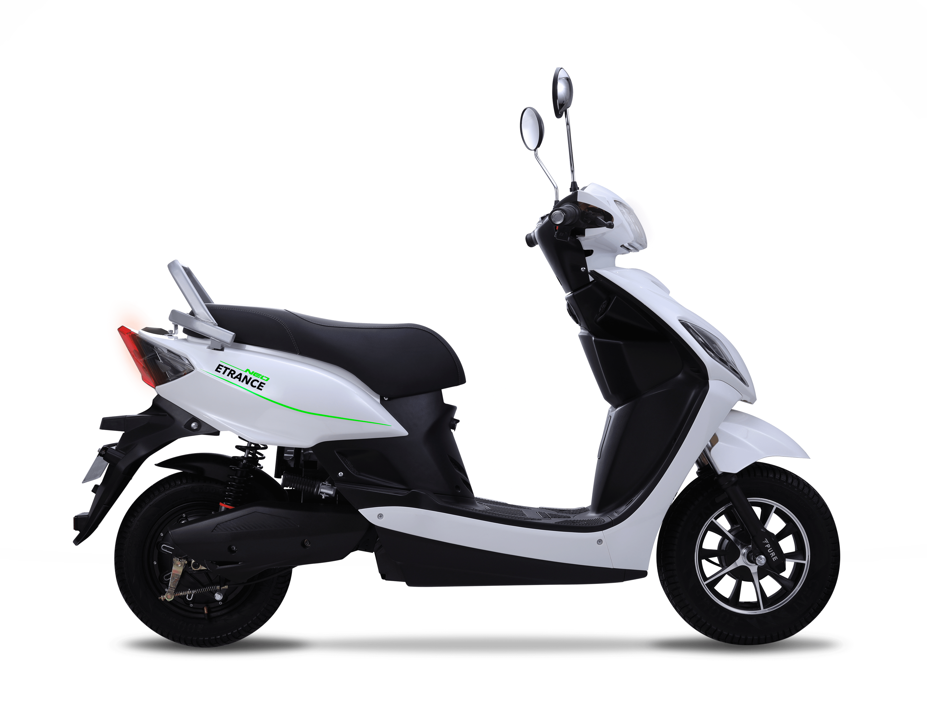
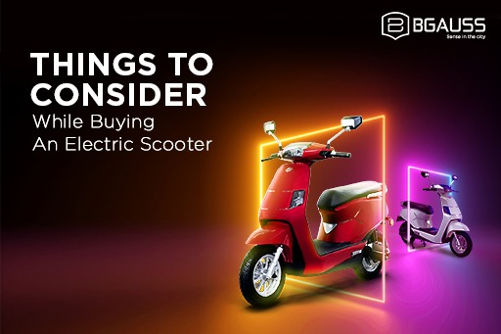
SPECS AND DETIALS OF
SPECIFIC MODEL
EV BRANDS
MODELS IN SPECIFIC BRAND
LOCATE NEAR BY STORE
7G
EPLUTO 7G
ETRANCE NEO
4.1
₹ 97,000
LOCATE STORE
BOOK A TEST RIDE

Slide 5
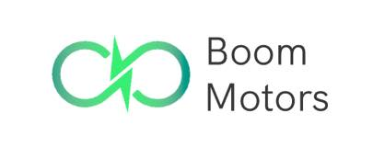
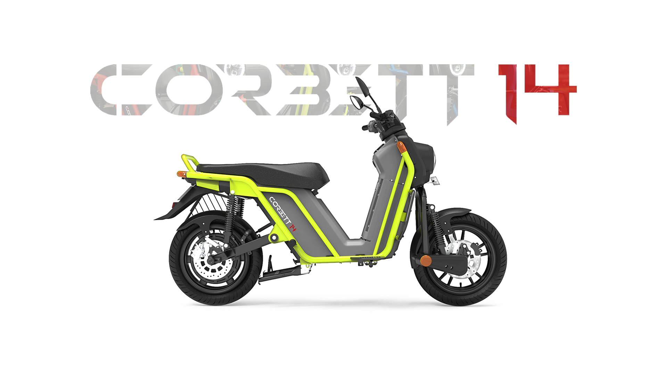
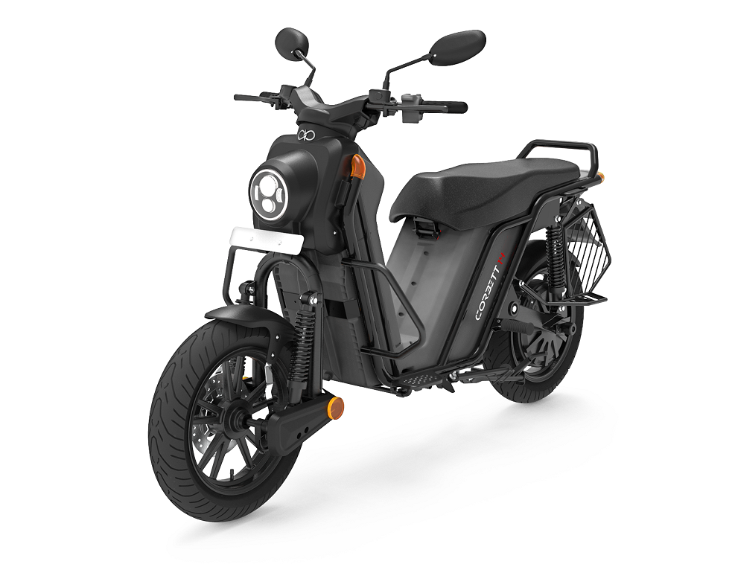
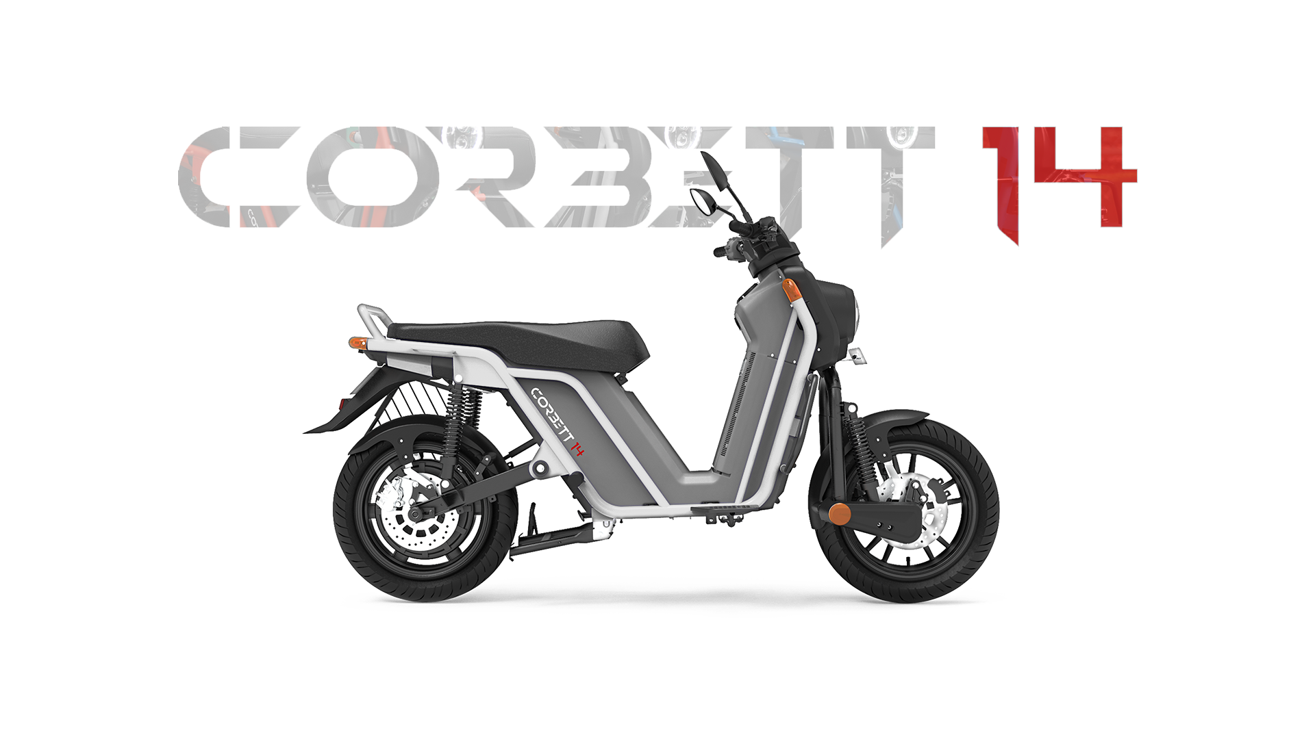
SPECS AND DETIALS OF
SPECIFIC MODEL
EV BRANDS
MODELS IN SPECIFIC BRAND
BOOK A TEST RIDE
Requirements for Test Ride
NAME
AADHAR NO.
CONTACT NO.
ADDRESS
AREA
LANDMARK
CITY
CORBETT 14 - EX
EX
4.1
₹ 1,38,000
LOCATE STORE
BOOK A TEST RIDE

Slide 6
VENERGY

Slide 7
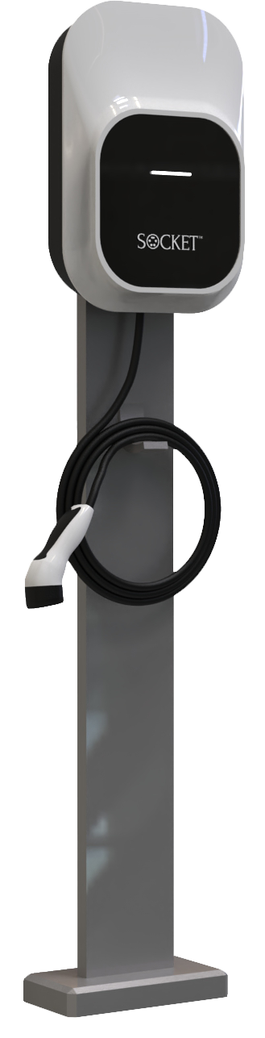
TYPE OF CHARGERS
WITH BRANDS
CHARGER SPECS
WITH UNIT IMAGES
Route to the selected
Charging station
SOCKET
CHARZER
SPECS
SLOW CHARGER – 3.3 KW
COMPATIBLE FOR 2 WHEELER
SOCKET
FAST CHARGER – 7.2 KW / 25 KW
COMPATIBLE FOR 3 & 4 WHEELER
LOCATE NEAR BY CHARGER

Slide 8
VENERGY

Slide 9
OPTIONS IN VEASE
UPON SELECTING
‘LOCATE SERVICE STATION’
UPON SELECTING
‘REQUEST ROADSIDE ASST’
Requirements to get roadside assistance service
NAME
CONTACT NO.
CURRENT LOCATION
LOCATE SERVICE STATION
REQUEST ROADSIDE ASSISTANCE

Slide 10
VEQUIPMENT COMING SOON

Slide 11
VESSENTIAL COMING SOON

